Slide 1
Budget Consultation Results
Your Police, Your Views 2022-23

Slide 2
Introduction and methodology
The Your Police, Your Views consultation launched on 17 December 2021 to seek to obtain the views of residents and ratepayers (local businesses) on the budget for policing, in line with statutory responsibilities.
Results from the consultation will inform the Commissioner’s decision making regarding revenue and capital spending and the level of the police precept.
An online survey was launched using Smart Survey, which ran for four weeks, to obtain the views of local people and gain feedback on potential options for the precept. A total of 839 responses were received by January 17.
A series of consultation meetings were also held with representative groups:
  Business and rural crime organisations
  Local MPs
  Town and parish councils
  Local Authority Chief Executives/Finance Leads and Council Leaders
  Police workforce representatives
  The Chief Constable and senior officer team

Slide 3
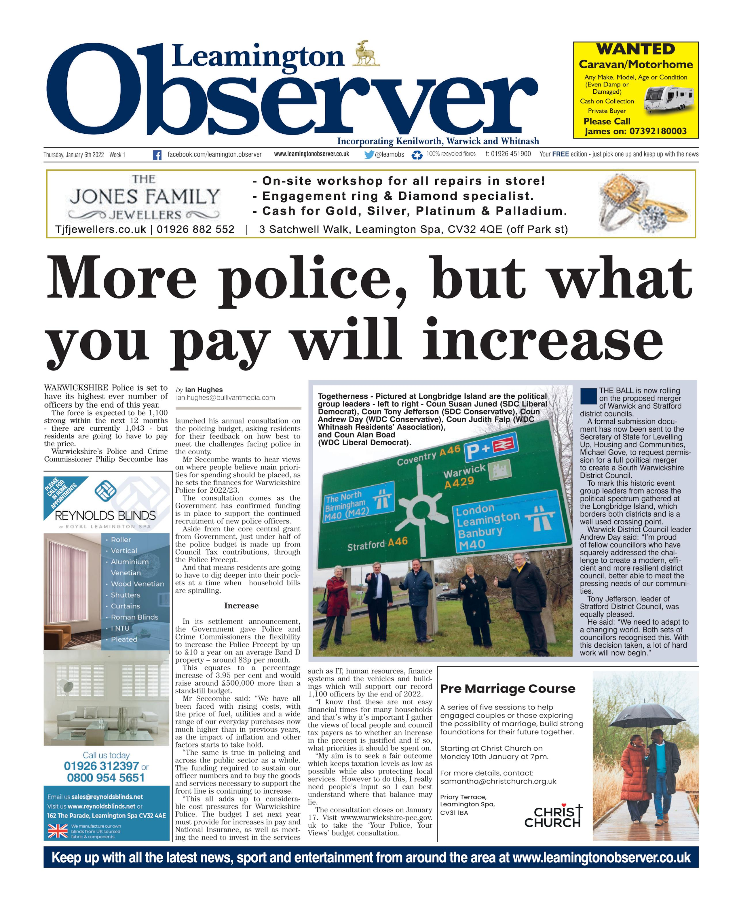
Promotion and uptake
The survey was promoted heavily on social media, including paid promotions on Twitter, Facebook and Instagram.
  On Facebook and Instagram we reached 56,000 users in Warwickshire
  On Twitter we reached a further 27,600 users within Warwickshire postcodes
  Facebook and Instagram ads resulted in 792 click-throughs to the survey
  Twitter ads resulted in 1,352 click-throughs to the survey
All town and parish councils were written to and asked to help promote the survey and encouraged to complete it.
An email newsletter was read 1,793 times, with 193 clicks to the survey
Internal communications were issued by Warwickshire Police and by partners, including within healthcare and local authorities.
Media releases resulted in coverage in the Stratford Herald, Leamington/Rugby/Stratford Observer, Redditch Advertiser during early January 2022.

Slide 4

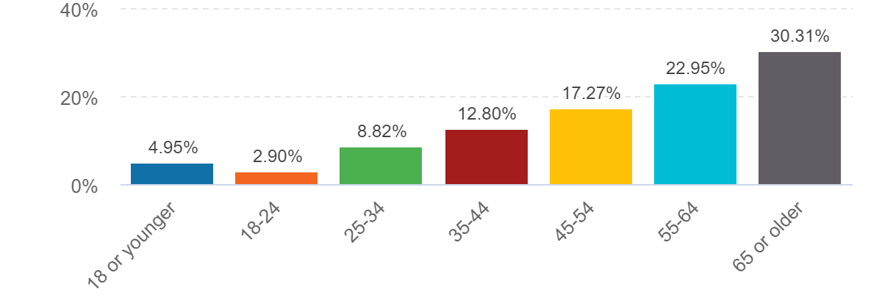
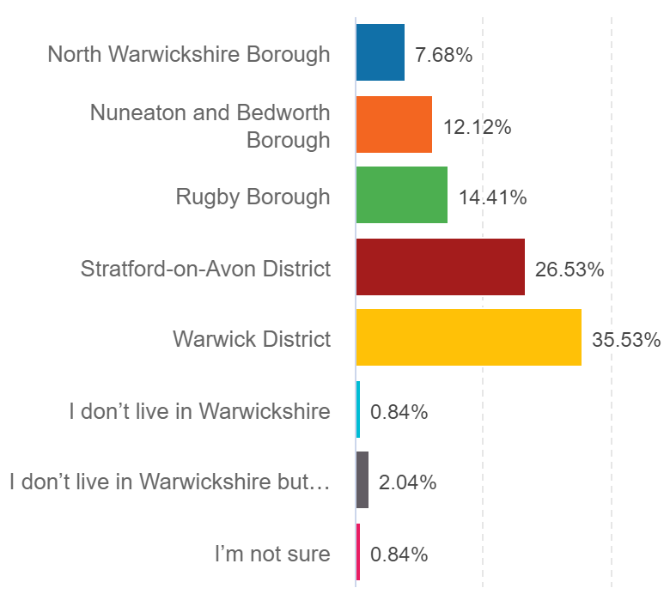

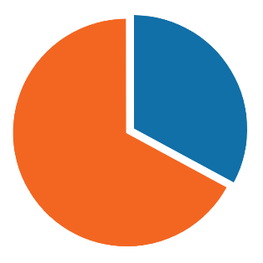
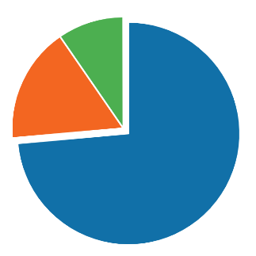
Respondent breakdown
Gender
Age
Area
62.38%
35.44%
Non-binary
0.61%
Self-describe
Police contact
Victim services
I don’t live in Warwickshire but I work or own a business there
1.58%
Have you contacted Warwickshire Police in the last year?
Do you know there are support services for victims?
Ethnicity
10%
White
96%
All other ethnic groups
4%
33%
Not
Sure
Council Tax payers
Yes
17%
No
Yes
No
67%
No
73%
Yes
93%
7%

Slide 5
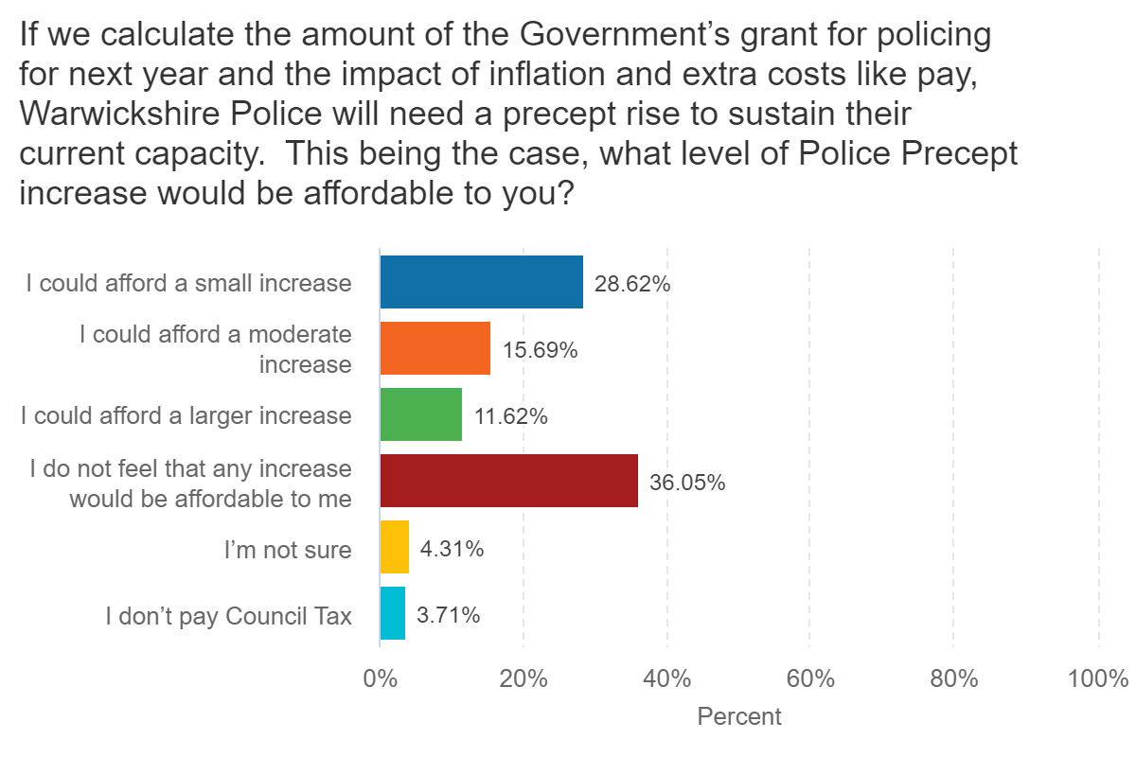
Summary of results
Affordability
We asked respondents in the online survey their views on the affordability of various options to increase the precept. The question had limited contextual information and was designed to find general opinions on affordability of Council Tax increases.
466 of respondents felt that some form of increase was affordable to them
  239 could afford a small increase
  131 could afford a moderate increase
  96 could afford a large increase
301 felt that no amount of increase would be affordable.

Slide 6
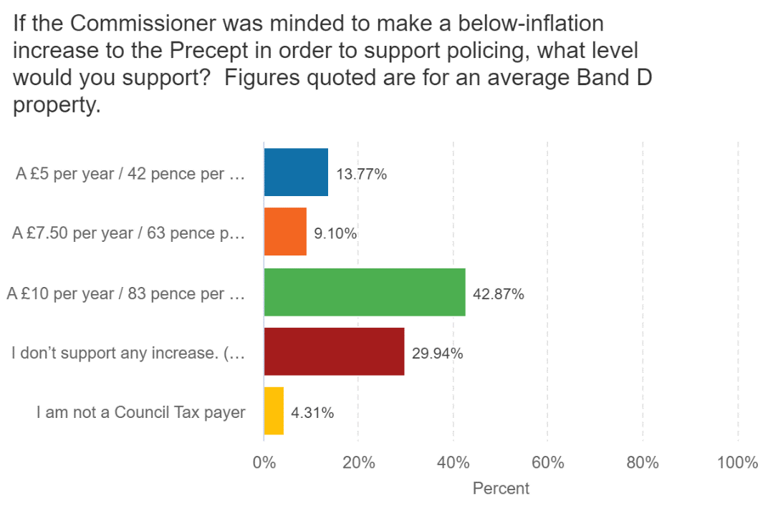
Summary of results
Precept option supported
We next gave four possible options for a change to the precept increase, providing a high level overview of the implications of each based on our early budget forecasting. We asked respondents to indicate which would be their preference, with figures quoted for an average Band D property.
  548 supported an increase of some kind:
    115 supported a £5 per year / 42p per month increase
    76 supported a £7.50 per year / 63p per month increase
    357 supported a £10 per year / 83p per month) increase
  250 support no increase
  36 do not pay Council Tax

Slide 7
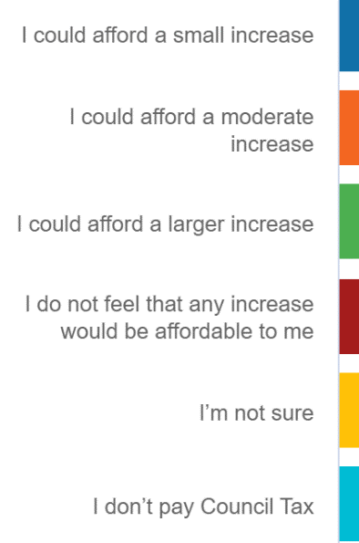
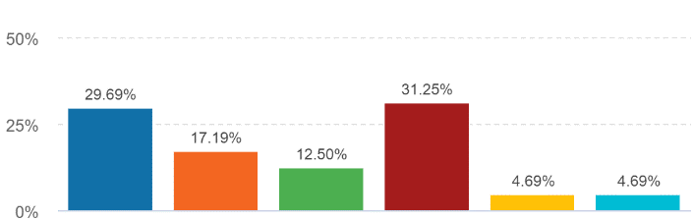
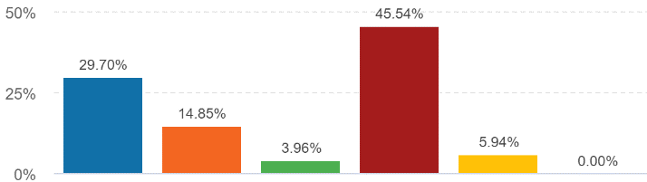
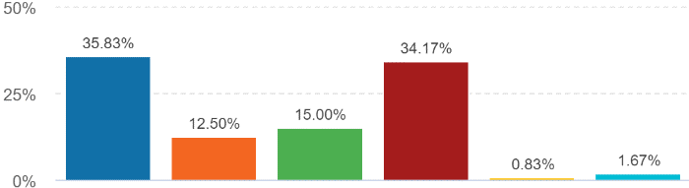
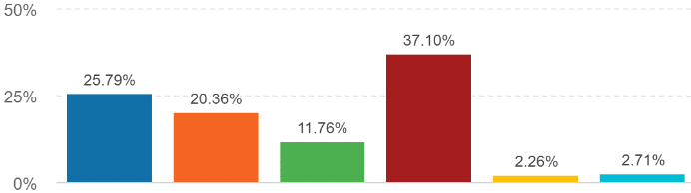
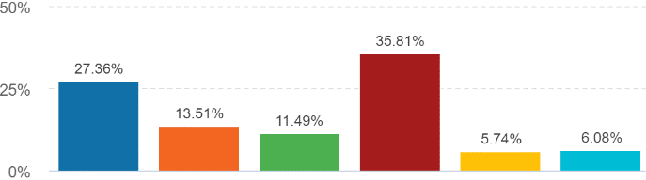
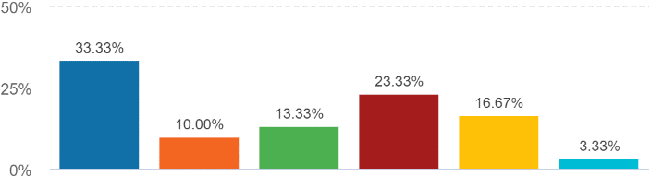
Most people view a precept increase as affordable
There are still significant numbers who view any raise as unaffordable, though the picture is different area by area
A larger proportion in Nuneaton & Bedworth (46%) cannot afford any increase
More people can afford a small increase in Rugby than no increase
Minority ethnic groups are less likely to find a raise unaffordable than average
Key Insights
39% view
a raise as unaffordable
61% view
a raise as
affordable
Results by demographic
North Warwickshire
Nuneaton & Bedworth
Rugby
Stratford-on-Avon
Warwick
Minority ethnic groups

Slide 8

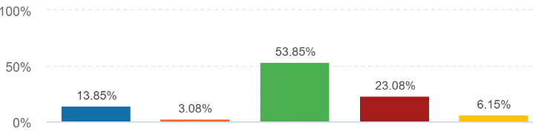
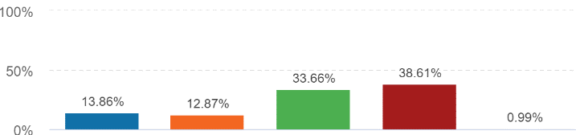
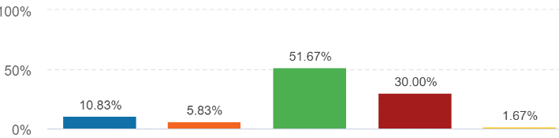
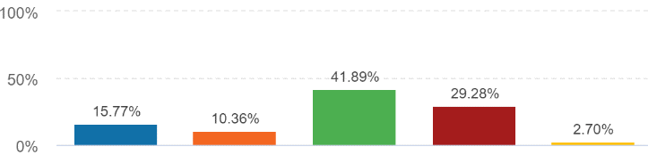
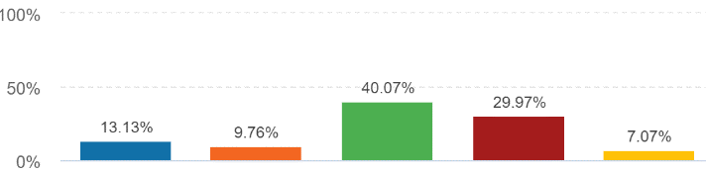
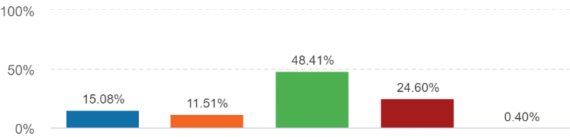
There is support for the maximum precept raise
With context around the size of an increase, support for the maximum raise increases considerably from 13% to 45%.
Older people (65+) support for a freeze only half of that of £10 raise
Nuneaton & Bedworth the only area where support for a freeze was the highest response, though a majority still support a raise.
Half of 18-24 year olds support the maximum raise; but 30% don’t pay Council Tax and 13% support a freeze.
Key Insights
31% do not
support any
raise
69%
support
some form
of raise
All
Taxpayers
Results by demographic
A £5 per year increase (Band D)
A £7.50 per year increase (Band D)
A £10 per year increase (Band D)
A precept freeze
(No increase)
Don’t pay Council Tax
North Warwickshire
Nuneaton & Bedworth
Rugby
Stratford-on-Avon
Warwick
Older people (65+)

Slide 9
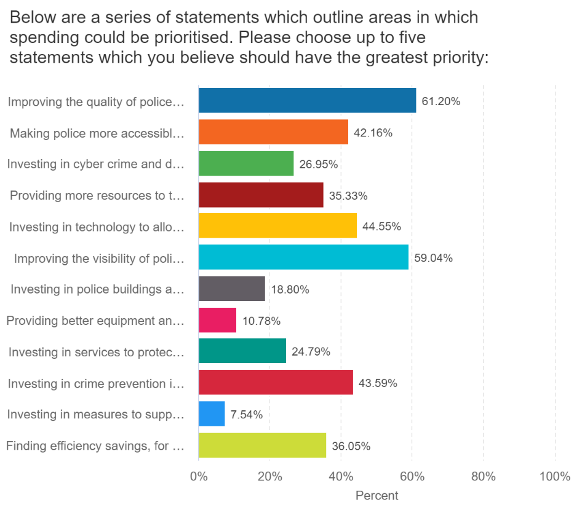
Priorities for spending
We gave a series of statements outlining areas where spending could be prioritised. Respondents were asked to select up to five statements which they felt should have the highest priority.
The top five results were:
  Improving the quality of police investigations
  with better outcomes for victims (61%)
  Improving the visibility of policing (59%)
  Investing in technology to allow front line policing
  to respond more efficiently and effectively (45%)
  Investing in crime prevention in the community (45%)
  Making police more accessible, including at police
  station front counters (42%)

Slide 10
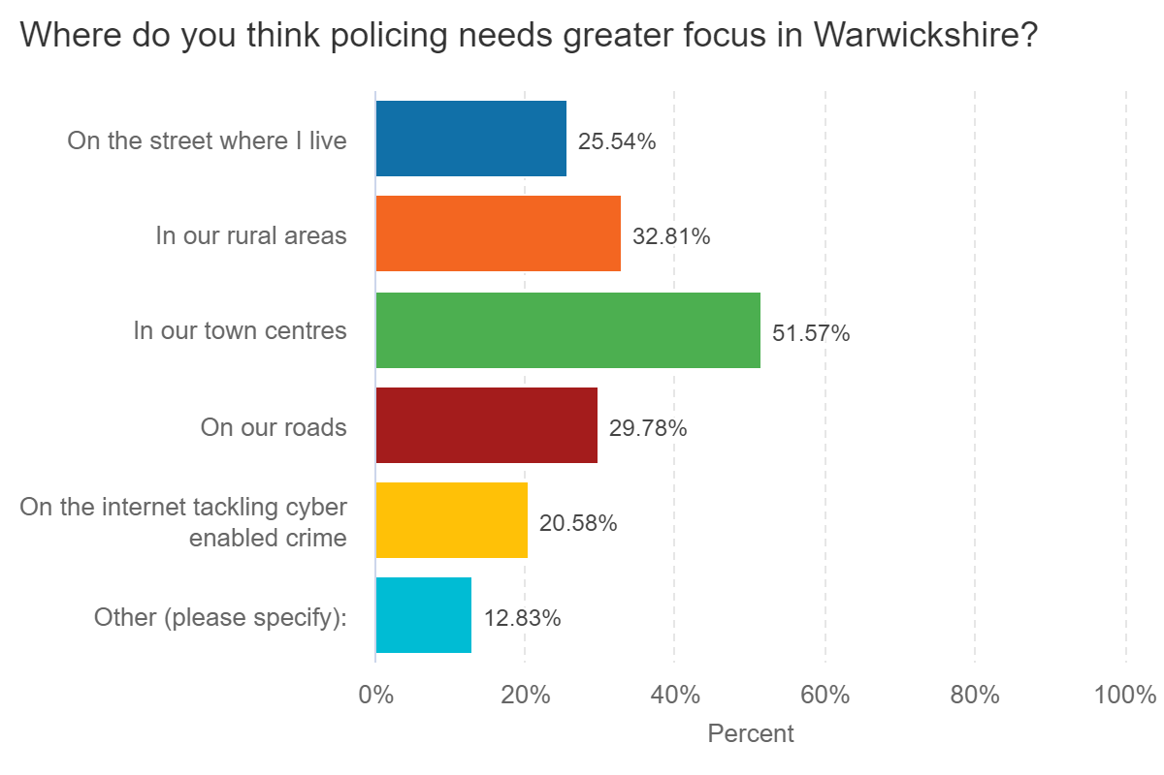
Where greater focus is needed
We asked respondents to state where policing needed a greater focus and gave a list of different options.
The results were:
  In our town centres (426)
  In our rural areas (271)
  On our roads (245)
  On the street where I live (211)
  On the internet tackling cyber enabled crime (170)
  Other (106)

Slide 11
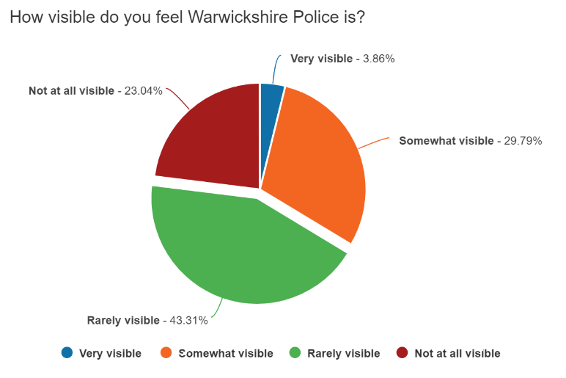
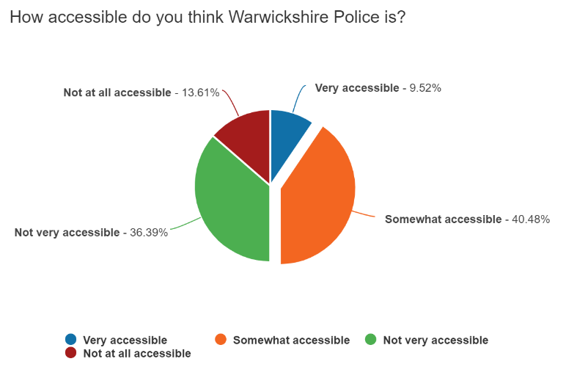
Visibility and accessibility
We asked respondents to state how visible Warwickshire Police is to them.
The results were:
  Rarely visible (358)
  Somewhat visible (247)
  Not at all visible (191)
  Very visible (32)
We asked respondents to state how accessible Warwickshire Police is to them.
The results were:
  Somewhat accessible (336)
  Not very accessible (302)
  Not at all accessible (113)
  Very accessible (79)

Slide 12
Conclusions
The survey shows there is a majority support for a precept raise, with just under half of responding taxpayers supporting the maximum raise.
There is nevertheless concern from around a third of respondents who do not support any raise.
The consensus from the face-to-face consultation meetings was that while no taxpayer is ever keen to see a raise, they can support it if the benefits being delivered are seen and felt.
However visibility and accessibility of policing are both areas which need to see clear improvement.
The priorities for spending identified in the consultation are supported by the additional benefits anticipated from the proposed budget:
  Improvements to investigative standards and outcomes with Evidential Review Officers.
  A strengthened response to violence against women and girls with investment in teams dealing with vulnerability.
  Extra officers to improve resilience and increased visibility, supported with appropriate equipment and fleet.
  Better equipment and enhanced training for Specials to further support SNT’s and provide increased visibility
  Improved ICT infrastructure and systems to enable flexible and remote working on more robust Warwickshire networks.
  Additional funding for the Commissioner’s grants to promote crime prevention activity and road safety.
  Improved public contact methods to improve accessibility of police, including front counters.

