Slide 1
Public Perceptions – Policing CoVID-19
Week 5 - FINAL
GSC | INSERT GSC | Author | Analysis and Service Improvement
Data Period | 18/01/2021 – 20/02/2021 | URN | ASI/2021/70
Version | 1.0 | Purpose | Summary analysis of CoVID-19 Phase 2 Survey results
Handling Instructions |  | This document must be handled and stored according to the GSC guidance.

Slide 2
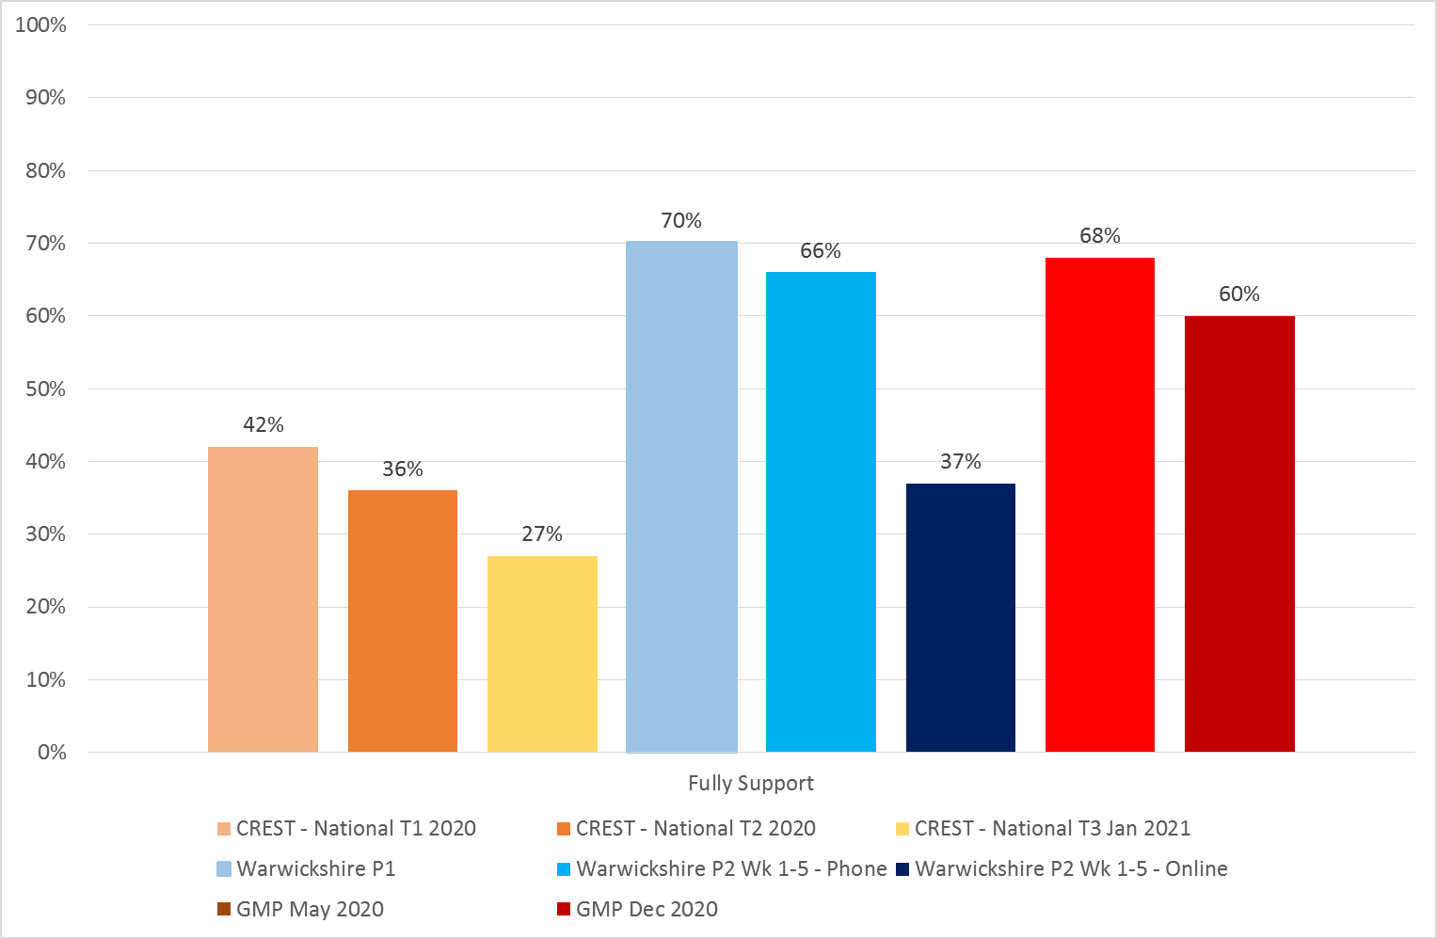
Headline
I fully support their approach
National v WP: Comparing the latest national (E&W) results for policing generally (CREST Advisory¹) to the force's phone survey², there is greater support for the force's approach (66% compared to 27%). This is consistent with P1 results.
P1 to P2: For all three surveys (CREST, GMP, Warwickshire Police (phone)), there has been a decline in those responding with full support. Nevertheless, for the force, the drop (4%), is less than in the comparison surveys (GMP down 8%; CREST down 9% drop).
Phone v Online: The online results are markedly different. In the online survey, support for the force's approach is lower at 37%. However, it should be noted that online results are particularly susceptible to sampling bias (self-selection).
CREST survey was run by YouGov using its panel methodology (https://yougov.co.uk/about/panel-methodology/)
Weeks 1-5, n = 400

Slide 3
Summary Table
Summary: How you feel Warwickshire Police is approaching the situation
Phone Survey: Of those respondents who are not fully supportive, the majority have responded that the force should take tougher action (18%). Nevertheless, from P1 to P2, this has fallen by 3% (from 21%), (whilst it has increased in comparison surveys). The main switch is participants responding “None of the above”, which has increased from 2% to 9%. Whilst further analysis is required, this may suggest that the force has been successful in redressing the enforcement balance.
As expected, online responses are more polarised, with more participants responding that the force is going too far or too heavy-handed (13%, 8% higher than the phone survey), whilst 37% think the force should take tougher action (compared to 18% in the phone survey).

