Slide 1
Road Safety Grant
Application Guidance

Slide 2
Road Safety in the Police and Crime Plan
“Road safety and the policing of our roads remains a key concern when I speak with local people across Warwickshire. Warwickshire has 143 miles of major motorway and A roads. Our roads need to be safe for those who use them. Policing and enforcement is only one aspect of road safety; the engineering of road layouts and education of road users are also vital partnership responsibilities.”
New developments in Warwickshire such as the building of HS2 and the 68, 500 new homes proposed to be built in Warwickshire by 2026 will bring challenges. Warwickshire roads will be affected and will need close scrutiny to ensure that the impact of future demand continues to be planned for and monitored effectively.
The Plan commits to making roads safer and reduce the number of people killed or seriously injured (KSI).

Slide 3
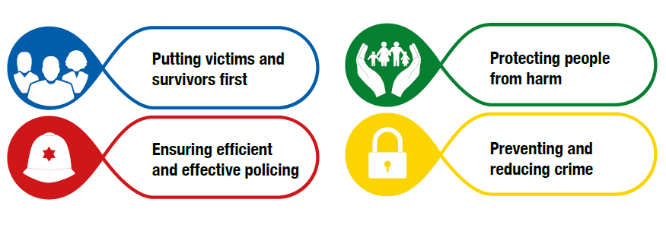
Road Safety fits into all of the core OPCC Priorities in the Police and Crime Plan

Slide 4
Your Priorities
Based on today’s discussion…

Slide 5
Guidance Notes
When we launch the Road Safety Grant Scheme in the next 2-3 weeks, we will issue a set of guidance notes.
The guidance notes will explain:
The legal and policy implications for applicant organisations e.g. constituted as a legal entity, published financial accounts, safeguarding policy etc.
What information must be provided about your project and when
What project types would and would not be eligible for funding
How bids are evaluated.
They are reflective of our priorities and research, and what partners like you have told us today and at other times.
Please read them!

Slide 6
What we are looking for…
Certain criteria are likely to strengthen your bid:
Contributing to the Police and Crime Plan aims (at least one is necessary, more are added value)
Measureable and demonstrable impact
Based on a clear and evidenced case of ‘need’
Planned and/or operated in a partnership/multiagency setting
Good value for money
Match-funding provided from elsewhere
Use of volunteers
Explanatory and comprehendible bid
Significant reach to a quantity of people benefitted, or significant qualitative impact on a few
Clear plan of how the project will be implemented.

Slide 7
Be wary of these pitfalls…
A bid may be weakened if:
Evidence for the project’s need is not appropriately evidenced
The bid is very brief or carelessly executed
The bid is generic (not specific to this grant)
Links to the grant criteria/Police and Crime Plan are not clearly drawn
Evidence of impact (if the project is pre-existing) is not provided.
There are few criteria which strictly exclude a bid except if:
A bid does not contribute to road safety
The project will not take place in Warwickshire or if the funding may not be directly deployed in Warwickshire
Guidance notes are ignored.

Slide 8
Our Expectations of Grant Recipients
Good and timely application to the grants process
Good communication
Honesty – if things change or there are “bumps in the road”, let us know
Forward planning for monitoring purposes
Regular monitoring/evaluation through quarterly returns and an end of year/end of project report
Publicity to include OPCC credit for funding
Return of unused funds at the end of the funding period
Support to OPCC in lessons learning and partnership work.

Slide 9
Application – Documentation to Submit
Safeguarding policies
Public Liability Insurance certificate
Appropriate staff training
Most recent set of published financial accounts
Risk assessments
Equality and diversity policy
Organisational Constitution
Modern Slavery commitment
Data Protection and GDPR policies
FOI – grounds for exemption

Slide 10
Evaluation
There is a stringent evaluation process for all of our grants’ schemes.
For the road safety grant scheme, a panel has been assembled of approximately 5 individuals from the OPCC and other organisations with appropriate expertise.
A minimum of 2 evaluation officers will evaluate each application and agree to an average score.
These scores and accompanying comments will be discussed for panel-wide approval, with the opportunity for dissention.
Panel recommendations will be put forward to the Police and Crime Commissioner for his decision.
Final decision rests with the Police and Crime Commissioner.

Slide 11
Timeline
12th April – Road Safety Networking Event
24th April – Road Safety Grant Launch (applications open!)
24th May – Road Safety Grant Applications Deadline
June – Evaluation
July – Applicants notified and payments processed

Slide 12
Thank-you for listening!
grants@Warwickshire.pnn.police.uk
Abby.Simkin@Warwickshire.pnn.police.uk
Christopher.Lewis@Warwickshire.pnn.police.uk
Any questions?

